Slide 1
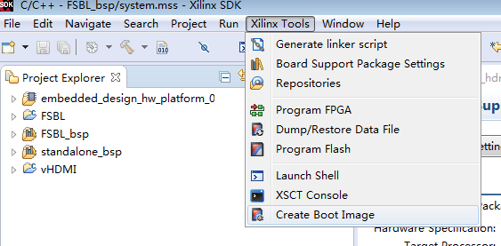
Create MCS file

Slide 2
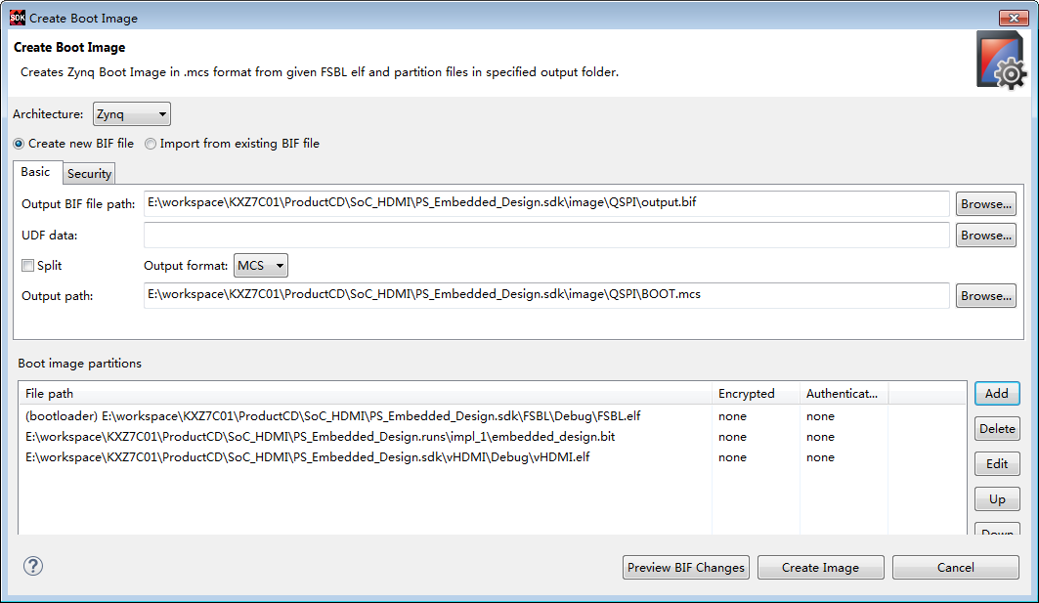
Create MCS file

Slide 3
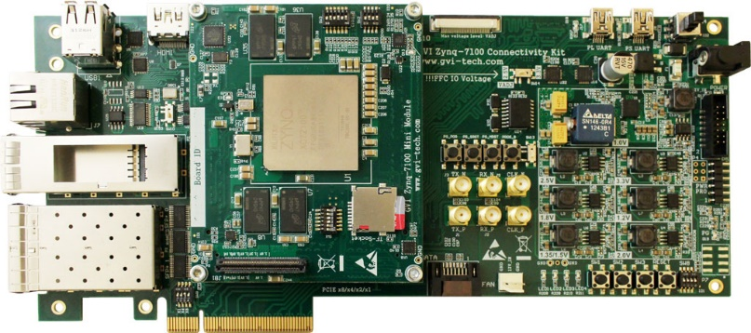
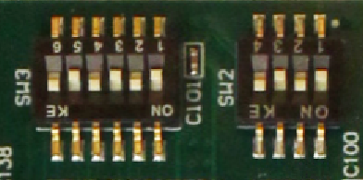
Write Flash
Before writing to Flash, make sure the boot mode is set to JTAG!
 | SW2 |  |  |  | SW3
 | 1 | 2 | 3 | 4 | 1 | 2 | 3 | 4 | 5 | 6
JTAG | OFF | ON | OFF | ON | OFF | ON | OFF | ON | OFF | ON
QSPI | ON | OFF | OFF | ON | OFF | ON | OFF | ON | OFF | ON
SD | ON | OFF | OFF | ON | OFF | ON | OFF | ON | ON | OFF

Slide 4
Write Flash

Slide 5
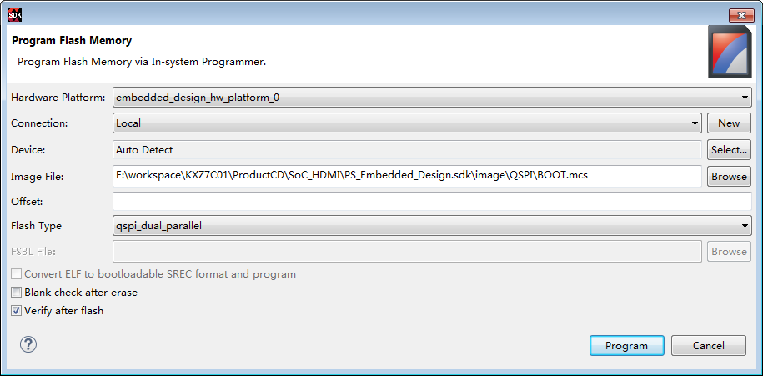
Write Flash

Slide 6
Boot from Flash
After writing to Flash, change the boot mode is set to QSPI.
 | SW2 |  |  |  | SW3
 | 1 | 2 | 3 | 4 | 1 | 2 | 3 | 4 | 5 | 6
JTAG | OFF | ON | OFF | ON | OFF | ON | OFF | ON | OFF | ON
QSPI | ON | OFF | OFF | ON | OFF | ON | OFF | ON | OFF | ON
SD | ON | OFF | OFF | ON | OFF | ON | OFF | ON | ON | OFF

